Slide 1
ANNELIDA: TROCHOPHORE LARVA
Dr. SEEMA JYOTI
ASSOCIATE PROFESSOR, DEPT OF ZOOLOGY
MANGALDAI COLLEGE

Slide 2
TROCHOPHORE LARVA
It is the larval stage in some polychaeta as well as molluscs and other phyla.

Slide 3
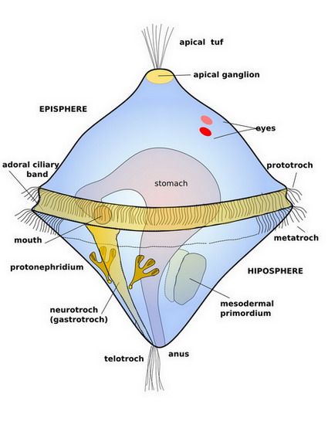
STRUCTURE OF TROCHOPHORE LARVA:
It is a minute, ciliated un-segmented somewhat biconical or oval structure with a protruding equator.

Slide 4
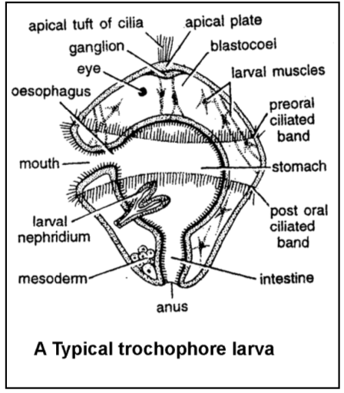

Slide 5
Its external surface consists of one-layered epithelium(ectoderm)thickened at the apical pole into a sensory plate, the APICAL PLATE or apical organ, which bears a tuft of cilia.
Above the equator there is a pre-oral ciliated band termed the PROTROCH which serves as the chief organ of locomotion and also directs a food bearing current towards the mouth which lies ventrally just below.
A second post oral ciliated band the METATROCH is present below the mouth and a ciliated circlet, the TELOTROCH, around the anus.

Slide 6
The larva has a complete ciliated digestive tract with oesophagus, large bulbous stomach, and a short intestine that opens through an anus at the lower pole.
There is a large cavity , the blastocoel, between the digestive tract and the ectoderm.
There may be present a ganglionic mass (apical ganglion) under the apical plate with a number of longitudinal nerves radiating from it, and below it there is an eyespot.
The larval excretory tube organ contains a flame cell and an excretory tube which opens to the exterior near the anus.
Mesoderm is the form of undifferented mass of cells located near the lower cone.

Slide 7
METAMORPHOSIS
The trochophore is pelagic, it drifts about in the seas swimming by its protroch. The adult organs begin to form.
Metamorphosis results in immediate termination of planktonic existence and loss of many larval structure-proto-nephridia , ecto-mesodermal muscle bands and ciliated girdles.
The development of the trochophore into the adult worm begins with the elongation of the lower region of the trochophore.
The elongated region becomes constricted into segments which soon develop bristles.

Slide 8
METAMORPHOSIS
The ciliated band disappear and the upper part of the trochophore becomes the head.
The apical organ forms the prostomium, brain, tentacles and eyes and the part immediately behind forms the peristomium.
Larva gradually grows in length with the formation and development of trunk segments in front of the pygidium.
The younger worm settles at the bottom, takes up a burrowing life and completes post larval developement and assume the habits of the adult.

Slide 9
PHYLOGENETIC SIGNIFICANCE
It is of great phylogenetic significance because it occurs in several phyla such as Annelida, Mollusca, Bryozoan .The trochophore larva has a significant contribution in the studies on evolutionary dynamics of invertebrates.
The trochophore larva acts as a connecting link between the bilateral and radial symmetries. It has been orated that the origination of bilateral symmetry occurred from the radial symmetry.

Slide 10
The life cycle of molluscs, like most of the invertebrates, comprises of single or several larval phases that are distinct from the adults. The trochophore larva is the larval stage involved in the development of annelids and molluscs.
This occurrence of trochophore larvae in annelids, as well as molluscs, proves that they have a very close evolutionary relationship.

Slide 11
THANK YOU

